Slide 1
ACM- “Transite Pipe” Management Plan
Developed by Arcadis Canada, implemented by the Mohawk Council of Kahnawà:ke (MCK) managed by the Public Safety Division (PSD)

Slide 2
ACM- “Transite Pipe” Management Plan
The Mohawk Council of Kahnawa:ke (MCK) has proactively addressed the presence of asbestos-containing material (ACM- Transite Pipe) in soils across various residential and undeveloped lots within the community.
Expert consultants have been commissioned to conduct extensive and comprehensive Human Health Assessments (HHA) to evaluate the potential health impacts of any ACM-Transite Pipe found in soil. This assessment was also aimed to understand ACM exposure and the development of an effective & safe plan for the community.

Slide 3
ACM- “Transite Pipe” Management Plan
In response to the all the findings from expert consultants, the Asbestos Containing Material (ACM) was developed and will be implemented to guide the management of ACM-Transite Plan going forward.
Because of the low risk assessment, the Management Plan emphasizes the importance of not disturbing soils that may contain ACM – Transite Pipe pieces.
A “leave it in place” approach will be followed.
Any lots in the community that have been identified as having ACM-TP in the soil will be surveyed annually during the spring thaws to ensure any surfaced pieces are removed by Public Safety.

Slide 4
ACM- “Transite Pipe” Management Plan
From the expert Consultant reports, its is important to note the key findings:
The likelihood of asbestos fibers becoming airborne is minimal, unless vigorous soil disturbance occurs.
The ACM Transite Pipe in the territory are mainly found in large & small pieces, such as cement pipes. These have very low potential for releasing fibers into the environment.

Slide 5
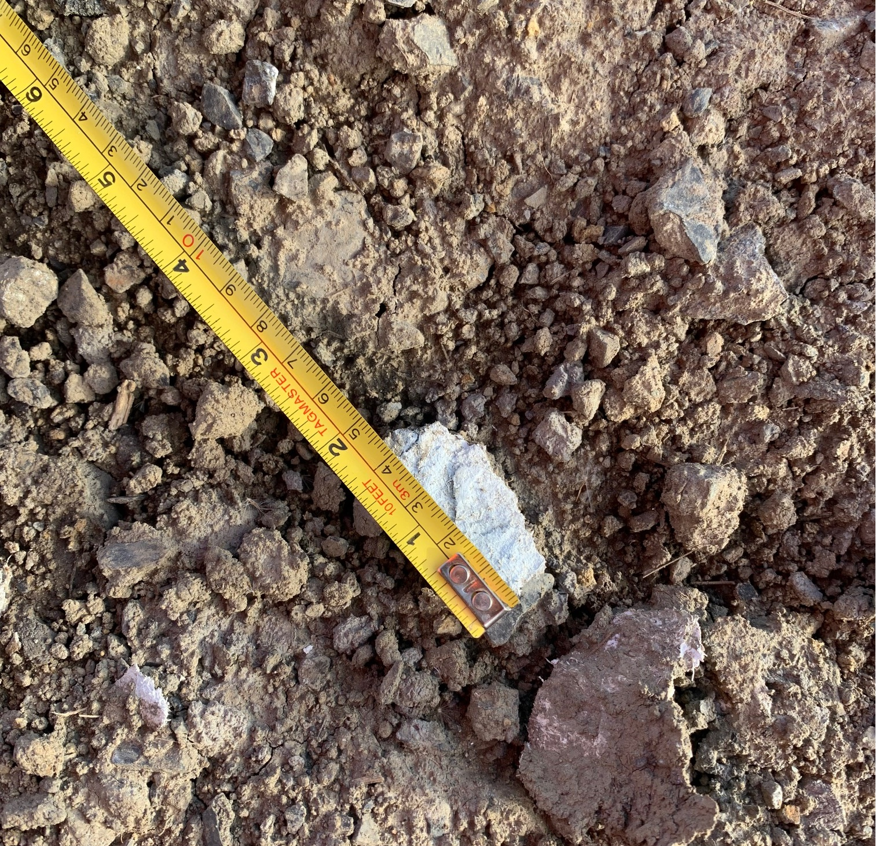
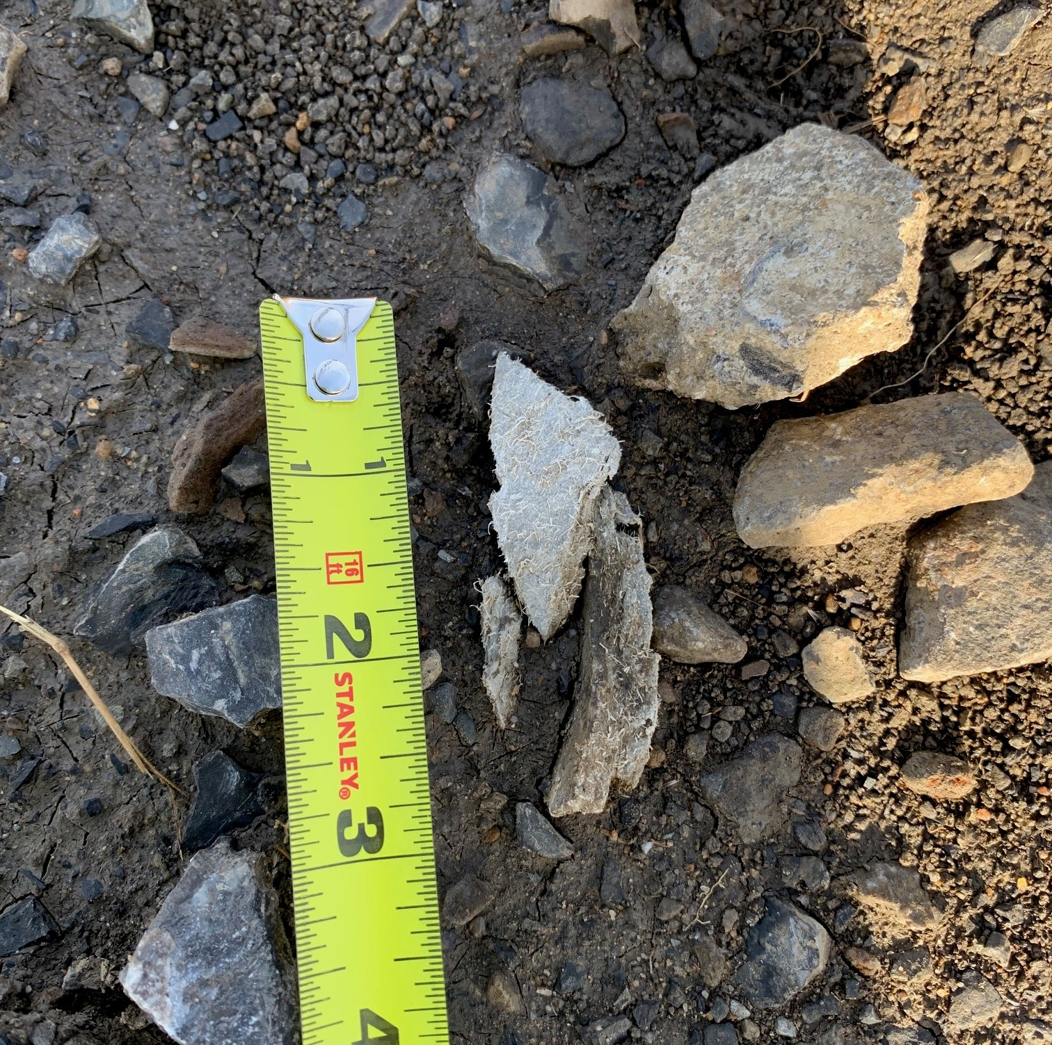
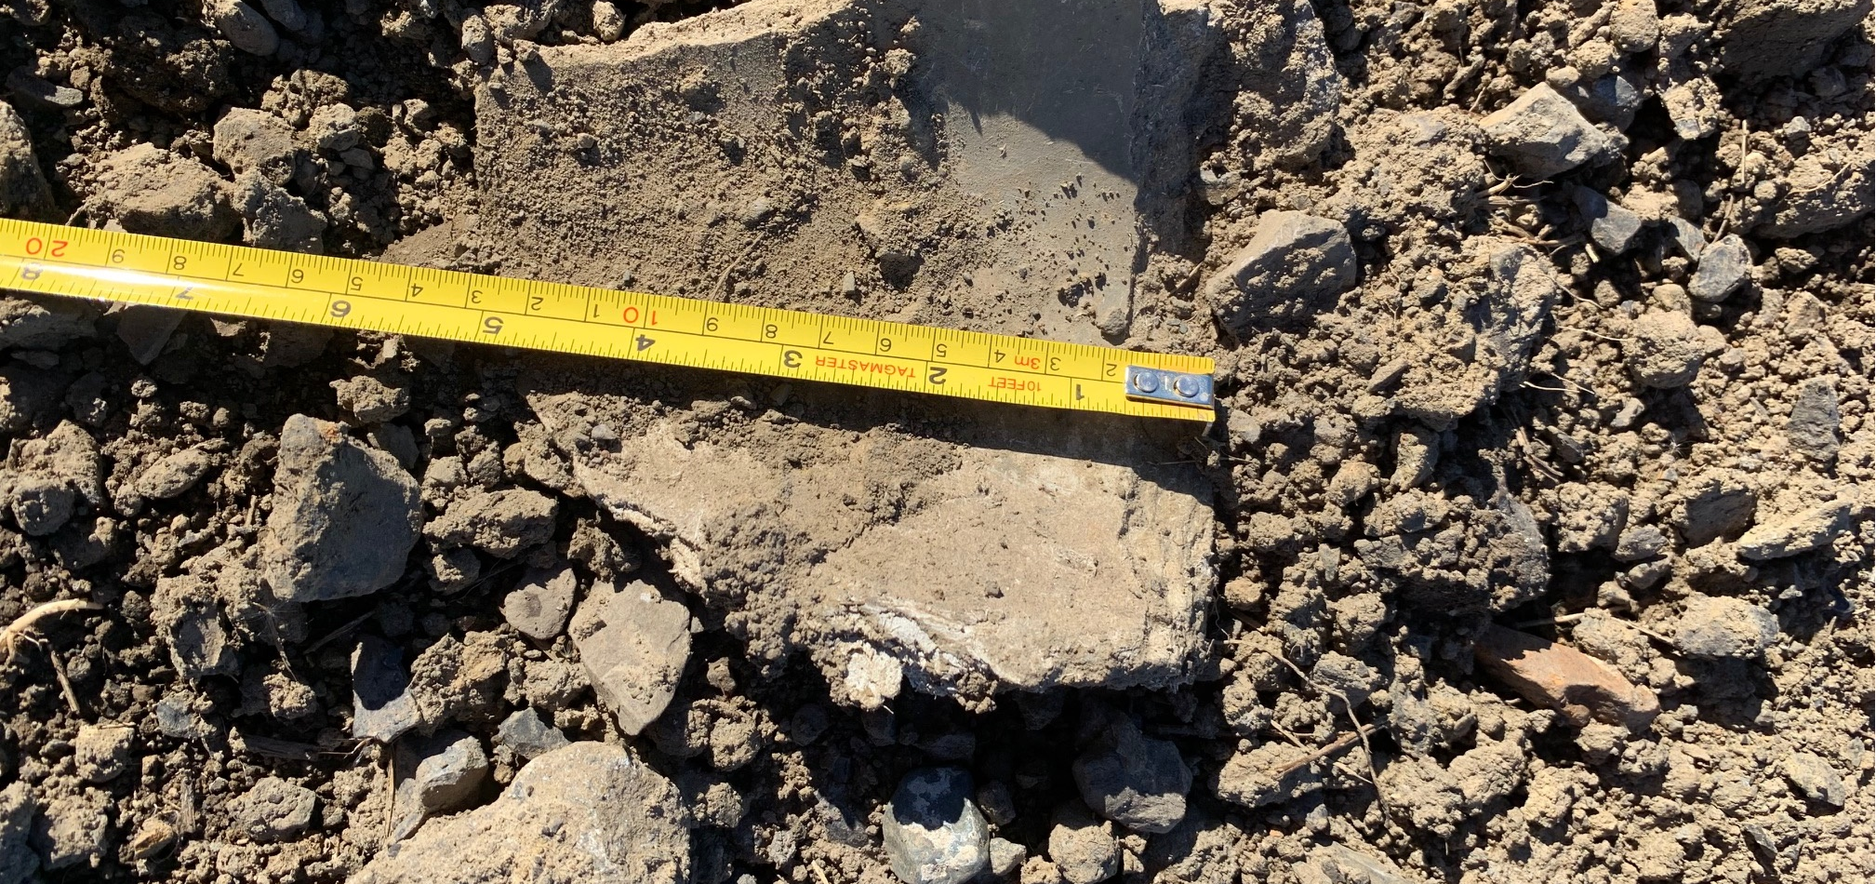
What does ACM Transit Pipe look like?
The Asbestos Containing Material (ACM) developed by Arcadis, adopted by MCK and managed by the Public Safety Division, outlines clear procedures for the community to handle Transite Pipe pieces safely.
The recommendation is to “leave it in place” under the soil, is the safest approach.
The ACM Management Plan does align with Quebec and Federal Regulations.

Slide 6
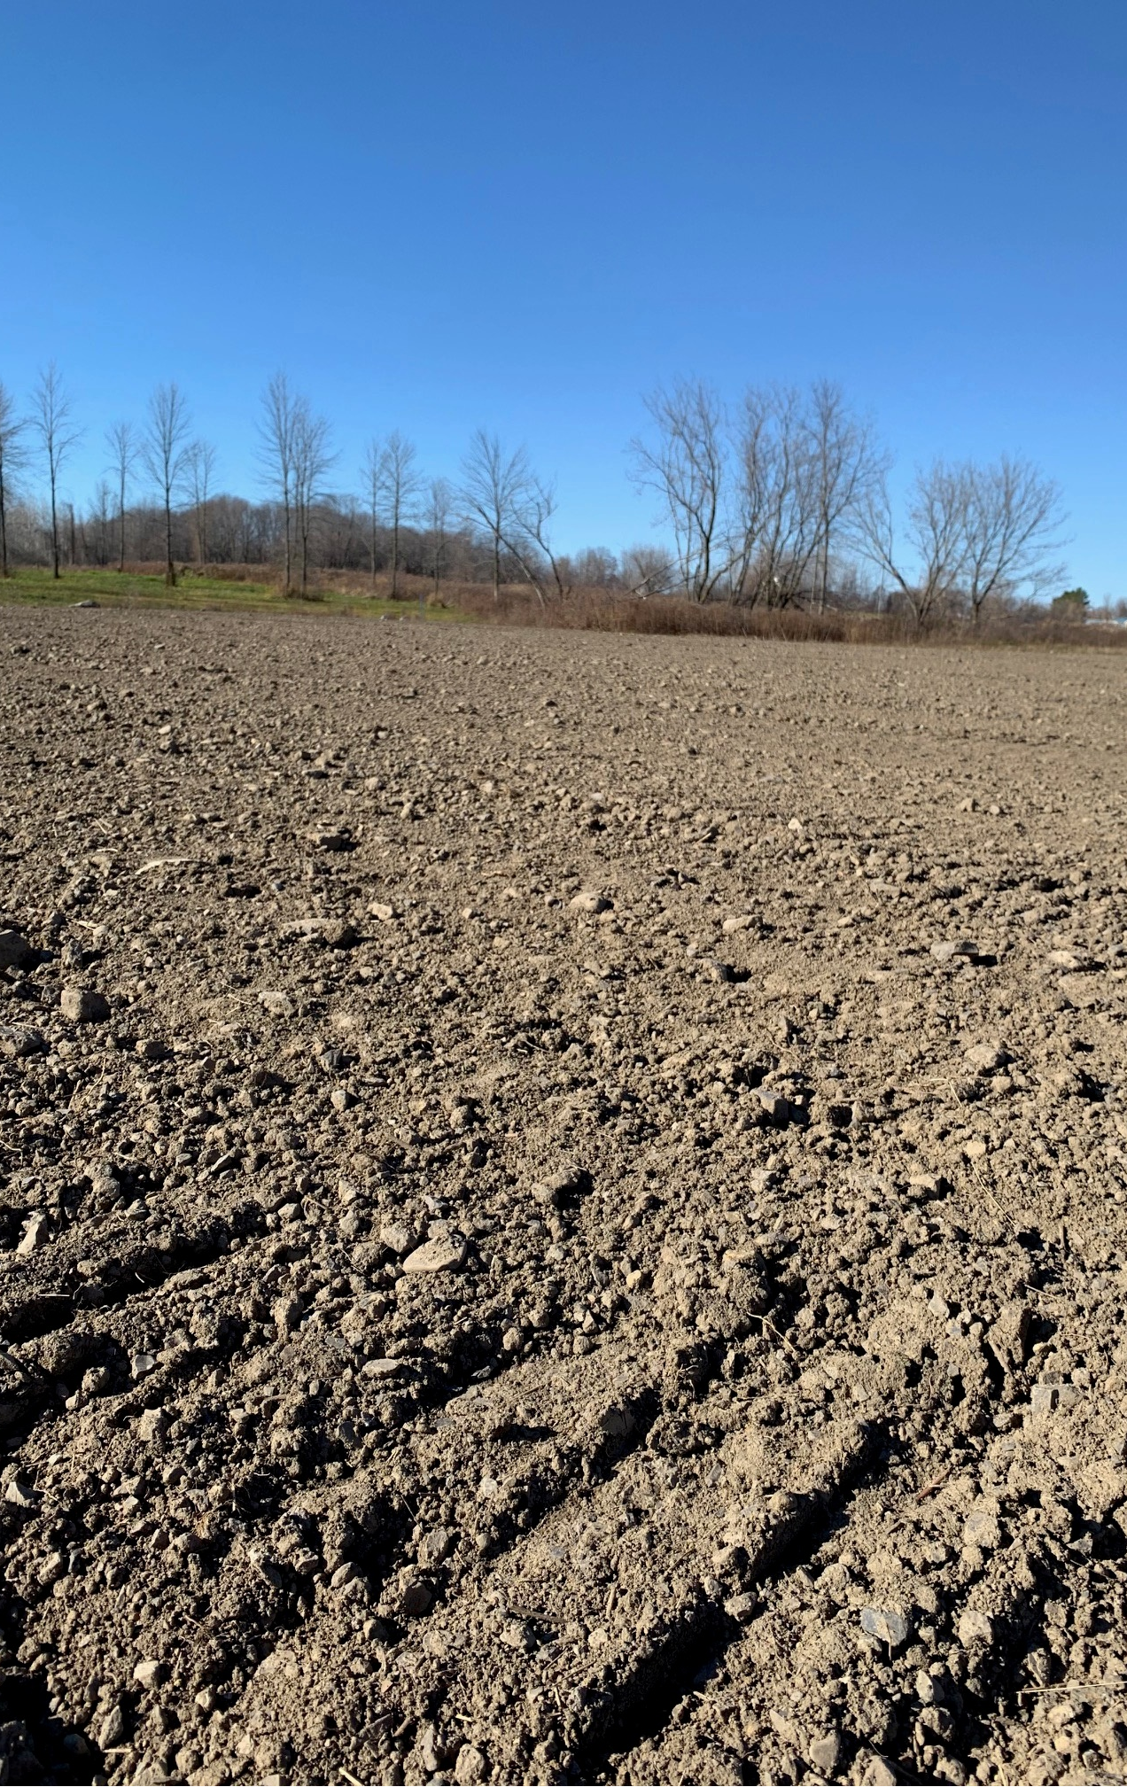
Management Plan: Every year after the snow melts and spring thaw, community areas will be surveyed for any visible ACM – TP that may have surfaced. For record and tracking purposes, Public Safety will remove any pieces and properly dispose of them.
“The Leave it in place” strategy is based on expert advise and a safe course of action.
Digging up soils with heavy machinery could break down ACM pieces and potentially release asbestos fibres.

Slide 7
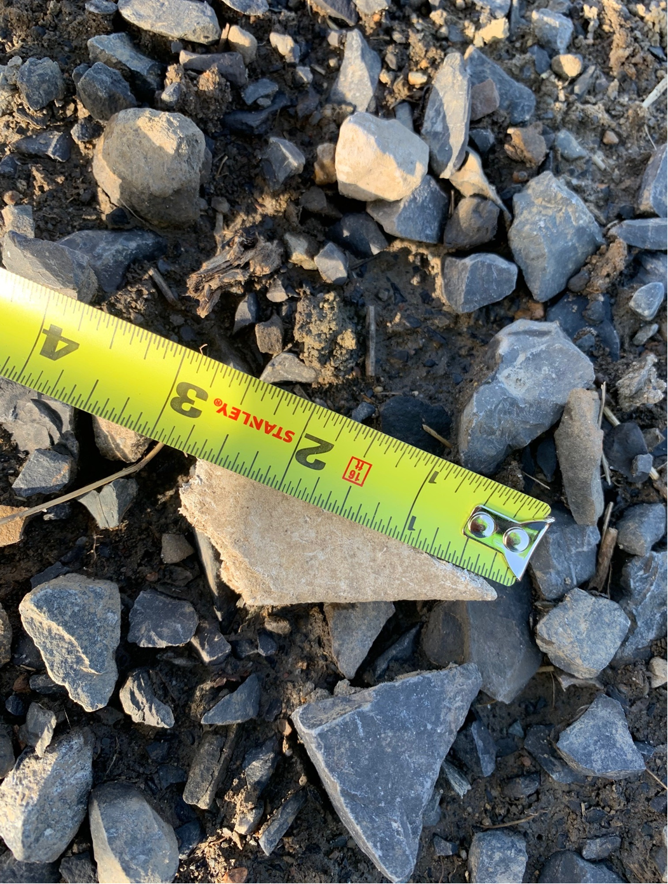
For homeowners & Individuals on impacted properties
When identifying ACM Transite pipe, look for the following:
Transite is a brand name for a type of fibre cement, a composite material made from cement reinforced with asbestos fibres.
Pieces in the soil appear to be made from a dense, cement-like material
The exterior might show signs of wear, such as chipping or cracking revealing fibres within.

Slide 8
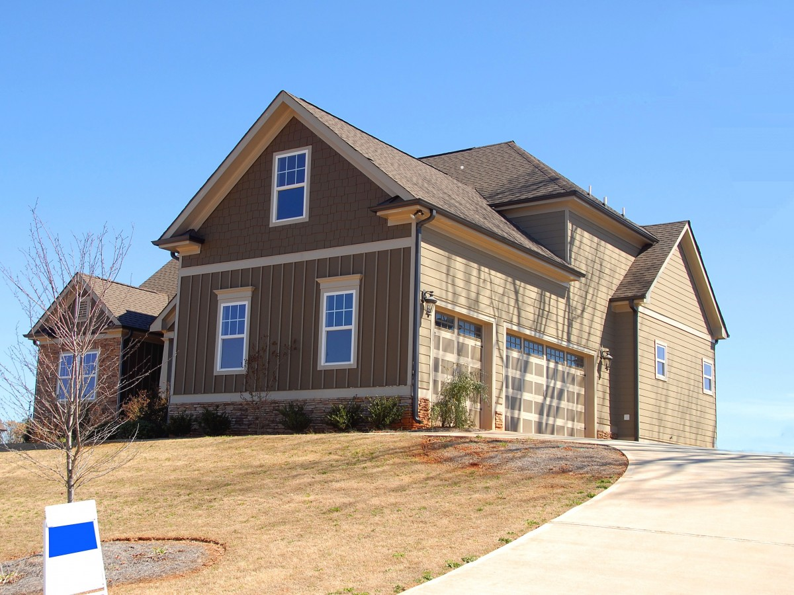
If your property has been identified as potentially having ACM in the soil, contact the MCK’s Public Safety Division before digging up the soil. For tracking & safety purposes; if you find a piece of ACM on your property, call the Public Safety Division (PSD) for removal. 450-632-0635

